Slide 1
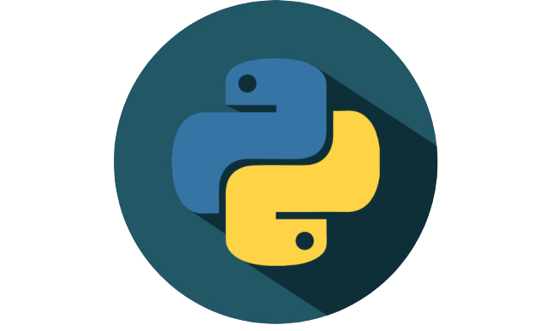
Python Function

Slide 2
Contents
Introduction
Defining Function
Function Parameters
Calling Function
Program workflow with function
Scope Rules
Python Standard Library

Slide 3
Introduction
In easy words, function is a code segment that does some specific tasks.​
It takes argument, does some calculation, and returns a result.​
2
2+5
7
5
Return Value
Argument
Calculation

Slide 4
Continue...​
There are two types of functions-​
Built-in functions​
print( ), input( ), float( ), etc are built-in functions​
looking familiar? Yes, we have already used them.​
these functions are already implemented in different libraries​
sometimes we need to import those libraries to use these function​
User defined functions​
we can write functions based on our requirement​
we use def keyword to define a function​
like as built-in function, we can use user defined functions multiple times​

Slide 5
Defining a function
A function begins with def keyword followed by function name, a set of parentheses and a colon (:)
Parentheses contains the parameters of the function. If the parentheses are empty, that means this function does not contain any parameters.
Function may have return statement to return a value. If there is no return statement, function does not return anything.
Statements after colon(:) with same indentation are considered as function’s block.
Parameters and all the variables within a function are local variables
Function
Here, def is the keyword
sum is the function name
(a, b) are the parameters
return c is the return statement
c=a+b & return c both statement have started with same number of spaces. These spaces are known as indentation. And for this these two statement are considered as the function’s block.

Slide 6
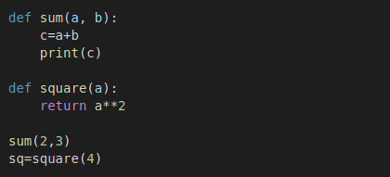
Calling a function
Function
A function can be called by the function name followed by a set of parentheses.
Parentheses contains the parameters.
If the function has return statement, a variable is used to store the return value.
A function can be called multiple times in a program. In the same way a single program can have multiple functions.
Here, sum( ) function does not have any return statement But square( ) function have return statement. That why the return value is has been stored in sq variable

Slide 7
Parameters
There can be three scenarios-
1. Function parameter can have multiple variables. Each variable should be separated by comma.
def fun(a, b, c, d):
2. Function can have default parameter value. But if the function is called with new values, they will override default values.
def fun(a=2, b="python", c=3.6):
3. Function can be defined without parameter. In that case, we do not need to pass any value while calling the function.
def fun():

Slide 8
What happens when we call a function?
# function
def fun(a, b):
print("I am Python")
# main code
print("Hello World")
fun()
print("Do you love me?")
No more text, let’s see that using a flow diagram

Slide 9
Scope Rules
Each identifier or variable is restricted by some regions according to its declaration. This region is known as scope.
That variable is totally unknown to program outside of its scope.
Basically there are two scopes; Global Scope, Local Scope When a variable is declared inside a function or class, it’s considered as in local scope.
When a variable is declared outside a function or class, it’s considered as in global scope.
Global Scope
Local Scope

Slide 10
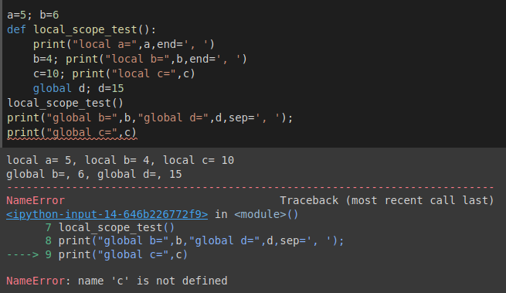
Continue...
If same identifier is used in global scope(outside of a function) and local scope(inside of a function), program treats them different variable. Variable of global scope can be accessed from anywhere. Variable of local scope are discarded when the function or class block ends. A variable declared inside a local scope can be treated as global by adding global keyword.
a is declared in global scope and accessible inside the function
b is declared in both scope and the program treated them as different.
d is declared in local scope but with global keyword, it is treated as global variable and accessible outside of function.
c is declared in local scope and when it was tried to access from outside of function, it shows an error.

Slide 11
Python Standard Library
Some important modules
collections —Data structures beyond lists, tuples, dictionaries and sets csv —Processing comma-separated value files (like those in Excel). datetime —Date and time manipulations. Also modules time and calendar . decimal —Fixed-point and floating-point arith- metic, including monetary calculations. math —Common math constants and operations. os —Interacting with the operating system. random —Pseudorandom numbers. string —String processing.
A module in python is a file that contains the group of related functions, data and classes.
Python standard library is a collection of such module that contains the core contents of python language.
Its packages and modules contain capabilities for a wide variety of everyday programming tasks.

Slide 12
Thank You

